Slide 2
NAKED AND COVERED POSITIONS
In the next few days we use as an example the position of a financial institution that has sold for $300,000 a European call option on 100,000 shares of a non-dividend paying stock.
S₀ = 49,
K = 50,
r = 0.05 or 5%,
σ = 0.20 or 20%,
T = 0.3846 or 20 weeks
The Black-Scholes-Merton price of the option is about $240,000 (that is, $2.40 for an option)

Slide 3
The Black-Scholes Option Pricing Formula
The price of a call option on a single share of common stock is:
C = S*N(d₁) – K*e^{–r(T)}*N(d₂)
P = Ke^{–r(T)} *N (–d₂) – S*N(–d₁)

Slide 4
BSM
Call option premium is = 2.40

Slide 5
BSM
Suppose market price of call option is 3.00

Slide 6

BSM

Slide 7
NAKED Strategy

Slide 8
NAKED Strategy
A trading strategy where the seller of an option contract does not own any, or enough, of the underlying security to act as protection against adverse price movements.
Naked trading is considered very risky since losses can be significant.
“An options trader could sell, for example, call options with a strike price of $50. If the stock's price falls to $20 or $30 on bad news, and the option is naked”. So option holder will suffer losses.

Slide 9

NAKED AND COVERED POSITIONS
The financial institution has therefore sold the option for $60,000 more than its theoretical value.
But the problem of hedging the risks.

Slide 10
NAKED AND COVERED POSITIONS
A naked position is very dangerous.
For example, if after 20 weeks the stock price is $60, then financial institution have to take loss of 700000$

Slide 11

COVERED POSITIONS

Slide 12
COVERED POSITIONS

Slide 13

Sirr by buying 100,000 shares as soon as the option has been sold we can earn 400000$
And sir I think this is the best strategy ever 100% profit.

Slide 14
COVERED POSITIONS
An options strategy whereby an investor holds a position in an option and cover position on that same asset in an attempt to generate increased income from the asset.
Like “ Writes (sells) call options and holds a long position in an asset on that same asset.”

Slide 15
COVERED POSITIONS
Okay means we should take cover positions?
Lets see sold 100000 call option we receive 300000$ and same time we buy 100000 shares @ 49.
If after 20 weeks the stock price is $60
We have to sell 100000@50 means 100000 profit
And 300000 from call premium
Total profit will be 400000$
Seems to be very nice deal

Slide 16
COVERED POSITIONS
Buy, If after 20 weeks the stock price is $30
Then no one will take your shares @ 50
M2M loss will be 2000000 minus 300000 (1700000$)
1700000$ loss

Slide 17
Sirr why don’t you buying one unit of the stock as soon as its price rises above K and selling it as soon as its price falls below K
By doing this, if at the end price of stock is 60$ then we have 100000 shares and if price is 30 $ then we don’t have any shares.
And we can end up with at least 300000$

Slide 18
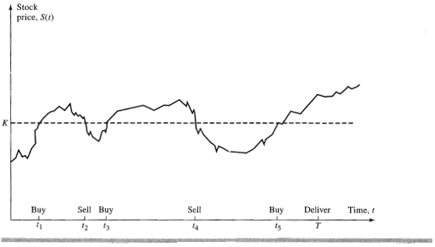
Stop loss strategy
Here buy and sell are very few.
Just think in real, market fluctuates infinite time. So we have to buy and sell infinite time. So again loss.

Slide 19

The answer is…
DELTA HEDGING

Slide 20
Delta
% Change in call premium due to change in 1 % change in stock price
Positive relationship between call premium and stock price
Delta hedging a written option involves a “buy high, sell low” trading rule

Slide 21
Delta
Delta is one of four major risk measures used by option traders.
Values range from 1.0 to –1.0
Call delta values range from 0 to 1.0
Put delta values range from 0 to –1.0
Long Call | Short Call | Long Put | Short Put
Delta Positive | Delta Negative | Delta Negative | Delta Positive

Slide 22
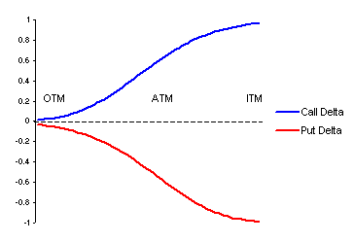
Delta

Slide 23


Slide 24
Delta
If other variables remain constant except S
Case 1: S, 100 110, K=100
Ln(S/K),0 0.09531, so D₁ tend to go up, as D₁ increase N(D₁) also increase, which is delta, vice-versa

Slide 25
D_{call} + D_{put} = 1
Rate of change is high with lower expire

Slide 26
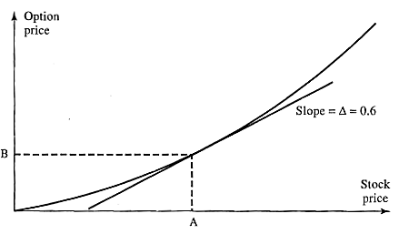
Delta Hedging with Options/Futures
Delta is slope
Call Delta = D_{C}= dC/dS D(call) = e^{-qt}N(d1)
Put Delta = D_{P} = dP/dS D(put) = e^{-qt} N(d1) — 1

Slide 27
Delta of a portfolio
Suppose a Stock broker has the following three positions
1. A long position in 100,000 call options (lot size -100) with strike price 55. The delta of each option is 0.533.
2. A short position in 200,000 call options with strike price 56.The delta of each option is -0.468.
3. A short position in 50,000 put options with strike price 56.The delta of each option is 0.508.

Slide 28
Delta of a portfolio
The delta of the whole portfolio is- 100,000 x 0.533 + 200,000 x (-0.468) + 50,000 x (0.508) = -14,900
This means that the portfolio can be made delta neutral with a long position of 14,900 with underlying.

Slide 29
Delta Hedging with Options/Futures
Call Delta = D_{C}= dC/dS
From Black-Scholes model,
D_{C} = N(d₁) (delta) we can calculate by BSM
S (stock price) = 74.49,
X (strike price)=75,
r (risk free rate) =1.67%,
σ (volatility) =38.4%,
t (time to expire)=0.1589 yrs.
Then, C (call premium)= 4.40
N(d₁) = 0.5197

Slide 30
Delta Hedging with Options/Futures
If S increases by $1, C is also increases by $0.5197
Hedge Ratio = H = 1/D_{C} = 1/0.5197 = 1.924
Sell 1.924 calls per share to hedge or sell .5197 stock per call.

Slide 31
Delta Hedging with Options
Delta changes over time!
Stock price changes
Time to expiration
Other factors like interest rates(r) and volatility change.

Slide 32

True Delta Hedging
Suppose we have 1000 IBM shares
To delta hedge these share we have to sell options
But how many???

Slide 33
True Delta Hedging
To know the number of options we first calculate hedge ratio = 1/delta
=1/.5197 = 1924 options sell

Slide 34
True Delta Hedging
IBM stock drops by $1 and we have 1000 shares =
Loss In stock $1000
Call options premium also drop by $0.5197 (as this is delta)
We have 1924 call short = 1924*.5191= $1000 Profit
Net P/L = ZERO
IBM stock rises by $1 = Gain in stock $1000
Call options also rise by $0.5197 and we have sell position in call option = 1924*.5191 = - $1000
= Net change 0

Slide 35
Example
A bank has sold for $300,000 a European call option on 100,000 shares of a non-dividend paying stock
S₀ = 49, K = 50, r = 5%, s = 20%,
T = 20 weeks, m = 13%
The Black-Scholes-Merton value of the option is $240,000
How does the bank hedge its risk to lock in a $60,000 profit?

Slide 36
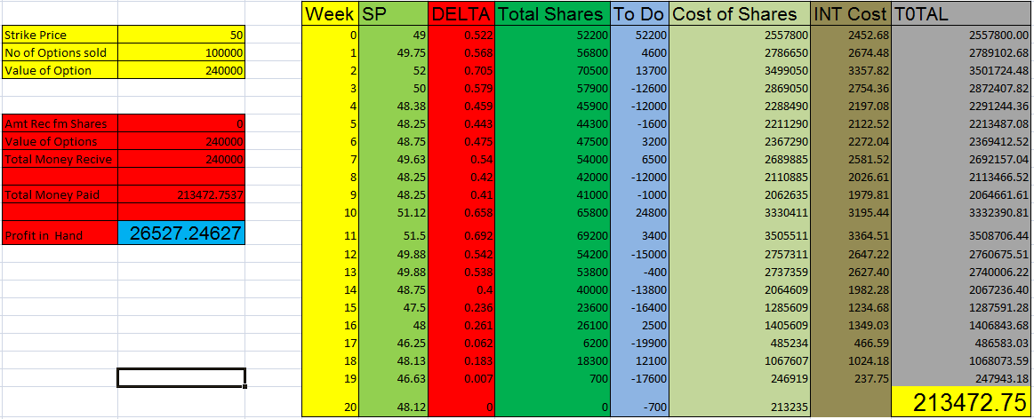
At Expire, Stock Price less than Strike Price

Slide 37
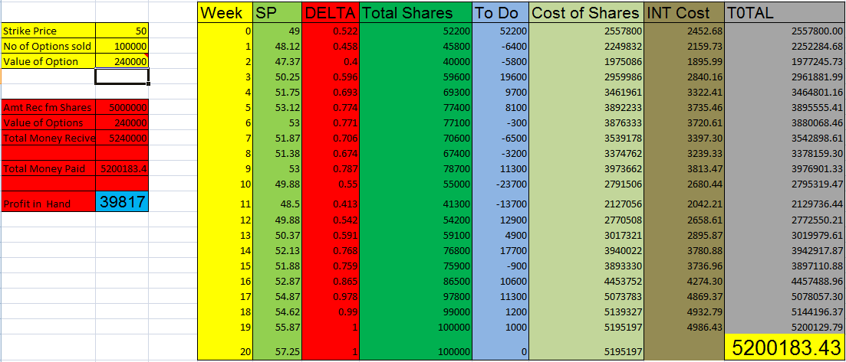
At Expire, Stock Price More than Strike Price

Slide 38
GAMMA
The gamma of an option indicates how the delta of an option will change relative to a 1 point move in the underlying asset. In other words, the Gamma shows the option delta's sensitivity to market price changes.
Gamma is important because it shows us how fast our position delta will change as the market price of the underlying asset changes.

Slide 39
GAMMA
In next slide, graph shows Gamma vs Underlying price for 3 different strike prices.
You can see that Gamma increases as the option moves from being in-the-money reaching its peak when the option is at-the-money.
Then as the option moves out-of-the-money the Gamma then decreases

Slide 40
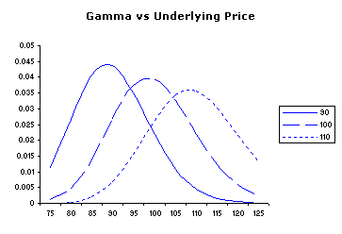

Slide 41
GAMMA
The Gamma value is the same for calls as for puts. If you are long a call or a put, the gamma will be a positive number.
If you are short a call or a put, the gamma will be a negative number

Slide 42
GAMMA
When you are "long gamma", your position will become "longer" (in case of delta hedging) as the price of the underlying asset increases and "shorter" as the underlying price decreases.
Conversely, if you sell options, and are therefore "short gamma", your position will become shorter as the underlying price increases and longer as the underlying decreases

Slide 43
GAMMA
The gamma (G) is the rate of change of the portfolio’s delta (D) with respect to the price of the underlying asset.

Slide 44
Calculate GAMMA
From Black-Scholes model,
S (stock price) = 74.49,
X (strike price)=75,
r (risk free rate) =1.67%,
σ (volatility) =38.4%,
t (time to expire)=15.89% yrs.

Slide 45
GAMMA
Calculation of Gamma

Slide 46
Calculation of Gamma
Because N(-d₂)=1-N(d₂), the theta of a put exceeds the theta of the corresponding call by rKe^{-rT}

Slide 47
Calculation of Gamma
Because N(-d₂)=1-N(d₂), the theta of a put exceeds the theta of the corresponding call by rKe^{-rT}

Slide 48
GAMMA
Calculation of Gamma

Slide 49
GAMMA
Making a portfolio gamma neutral
A delta-neutral portfolio has a gamma equal to Γ
A traded option has a gamma equal to Γ_{T}
The number of traded options added to the portfolio is w_{T}
Calculation of Gamma

Slide 50
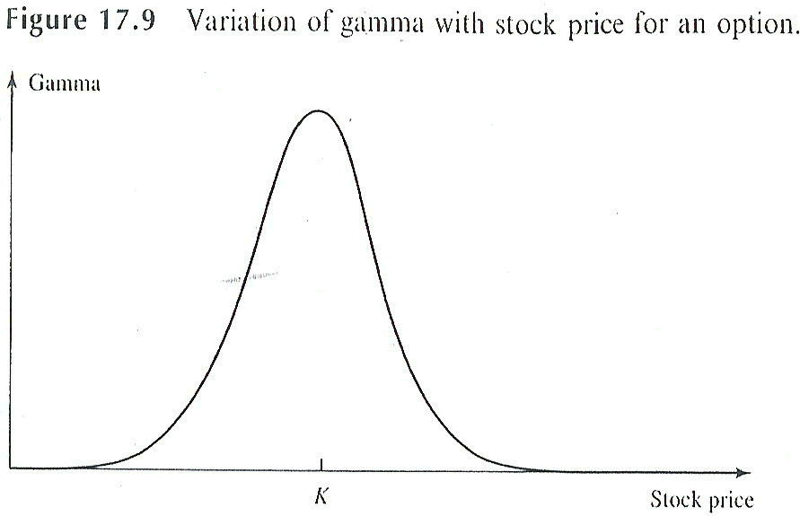
GAMMA

Slide 51
Gamma Neutral

Slide 52
Gamma Neutral Hedging
The rate of change of the portfolio’s delta with respect to the price of the underlying asset.
It is the second partial derivative of the portfolio with respect to asset price:
Gamma Neutral Hedging is the construction of options trading positions that are hedged such that the total gamma value of the position is zero or near zero, resulting in the delta value of the positions remaining stagnant no matter how strongly the underlying stock moves.

Slide 53
Gamma Neutral Hedging - Introduction
It prevents the position from reacting to small changes in the underlying stock.
It is still prone to sudden big moves which can take option traders off guard with no time to dynamically rebalance the position at all.
By Gamma Neutral, delta value is completely frozen.

Slide 54
Purpose Of Gamma Neutral Hedging
The main purpose of Gamma Neutral Hedging is to keep the delta value of a position completely stagnant no matter how the underlying stock moves.
This has 2 purposes;
To reduce the volatility of an options trading position by keeping delta low and stagnant delta.
To make a profit from speculating in implied volatility, which is represented by Options Vega.

Slide 55
Delta Positive, Gamma Neutral Example:
To keep delta value positive at 0.6 .
Stock price A is trading at $28.60
Its May 27.5(strike price) Calls Delta is 0.779 and Gamma is .18
Its Oct 27.5 (strike price) Calls Delta is 0.697 and Gamma is 0.085.
To keep delta value positive at .6
I would short 1 contract of May 27.5 Calls and buy 2 call of Oct 27.
Position Delta = (0.697 x 2) - (0.779) = 0.615
Position Gamma = (0.085 x 2) - (0.18) = -0.01 (which is very near to complete zero and can be regarded as gamma neutral)

Slide 56
Trading Implied Volatility
Delta Neutral, Gamma Neutral positions perfect for trading volatility.
The only significant options greek that remains unhedged is the Vega in a delta neutral, gamma neutral position.
A delta neutral, gamma neutral position would be long Vega.
A Completely Gamma neutral position would also have completely zero theta.

Slide 57
Delta Neutral, Gamma Neutral Example:
Stock A is trading at $28.60 and
Its May 27.5 Calls have 0.779 delta, 0.024 Vega and 0.18 gamma
Its Oct 27.5 Calls have 0.697 delta, 0.071 Vega and 0.085 gamma.
I want delta neutral and gamma neutral while keeping vega positive,
By taking 5 sets of “short 1 contract of May 27.5 Calls and buy 2 call of Oct 27.5” and then hedging it by shorting 3 shares of Stock A.
Position Delta = ([(0.697 x 2) - (0.779)] x 5) - 3 = 0.075 (which is very near to zero)
Position Gamma = ([(0.085 x 2) - (0.18)] x 5) = -0.05 (which is very near to zero)
Position Vega = ([(0.071 x 2) - (0.024)] x 5) = 0.59

Slide 58
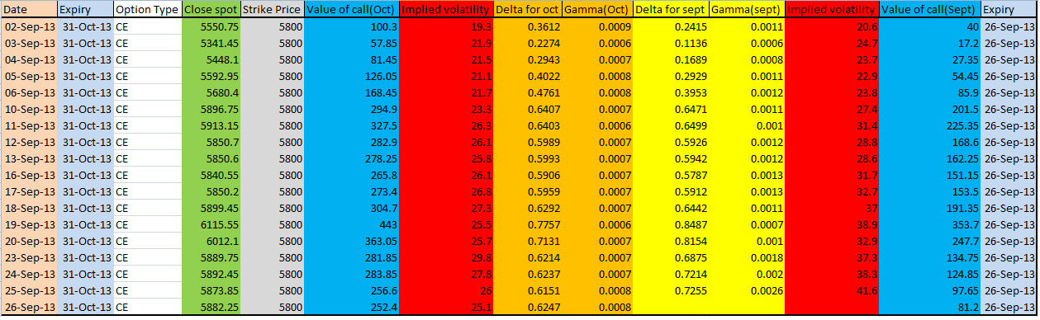
Example (Real Data)

Slide 59
Delta Neutral, Gamma Neutral *when Oct undervalued and sept overvalued
Lets understand how we can calculate Delta Neutral, & Gamma Neutral.
On 3rd of sept Delta(oct) = .2274, Gamma(oct) = .0006
Delta(sept) = .1136, Gamma(sept)= .0006
So, I will buy 1 call option of oct month & sell 1 call option of sept month
Then net gamma will be zero (.0006-.0006),
And net delta will be .1138 (.2274 -.1136)
by taking 9 sets of “short 1 contract of Sept 5800 Calls and buy 1 call of Oct 5800” and then hedging it by shorting 1 Nifty.
Position Delta = ([(0.2274 x 1) - (0.1137 x 1)] x 9) - 1 = 0.0242 (which is very near to zero) Position Gamma = ([(0.0006 x 1) - (0.0006)] x 9) = 0

Slide 60
Delta Neutral, Gamma Neutral *when Oct overvalued and sept undervalued
Lets understand how we can calculate Delta Neutral, & Gamma Neutral.
On 3rd of sept Delta(oct) = .2274, Gamma(oct) = .0006
Delta(sept) = .1136, Gamma(sept)= .0006
So, i will sell 1 call option of oct month & buy 1 call option of sept month
Then net gamma will be zero (.0006 -.0006),
And net delta will be -.1138 (-.2274 +.1136)
by taking 9 sets of “short 1 contract of Oct 5800 Calls and buy 1 call of Sept 5800” and then hedging it by long 1 Nifty.
Position Delta = ([(-0.2274 x 1) + (0.1137 x 1)] x 9) + 1 = -0.0242 (which is very near to zero) Position Gamma = ([(0.0006 x 1) - (0.0006)] x 9) = 0

Slide 61
Cont….
Delta Neutral, Gamma Neutral when Oct overvalued and sept overvalued :
Then we will sell high over valued and buy low overvalued.
Delta Neutral, Gamma Neutral when Oct undervalued and sept undervalued :
Then we will sell less undervalued and buy large undervalued.

Slide 62
Cont….
So total exposure is = ([(57.85 x 1) - (17.2 x 1)] x 9) = 365.85
And 1 nifty sold @ 5341.45
Suppose price of nifty moves to 5500 on same day
Then new value of call option of Oct month is 104.1388 and Sept month is 46.64 (assuming same implied volatility)
So new total exposure is = ([(104.1388 x 1) - (46.64 x 1)] x 9) = 517.4892
Loss in nifty futures = (5341.45 – 5500) = 158.55
Combined exposure is 517.4892 – 158.55 = 359.
Difference is 7

Slide 63
Case 2
On Sept 16 ,how we can do Delta Neutral, & Gamma Neutral.
On 16th of sept Delta(Oct) = .5906, Gamma(oct) = .0007
Delta(sept) = .5787, Gamma(sept)= .0013
So, i will buy 13 call option of oct month sell 7 call option of sept month
Then net gamma will be zero
And net delta will be = ([(0.5906 x 13) - (0.5787 x 7)] ) = 3.6269
by taking 8 sets of “short 7 contract of Sept 5800 Calls and buy 13 call of Oct 5800” and then hedging it by shorting 29 Nifty.
Position Delta = ([(0.5906 x 13) - (0.5787 x 7)] x 8) - 29 = 0.0152 (which is very near to zero) Position Gamma = ([(0.0007 x 13) - (0.0013 x 7)] x 8) = 0

Slide 64
Cont….
So total exposure is = ([(265.8 x 13) - (151.15 x 7)] x 8) = 19178.8
And 29 nifty sold @ 5840.55
Suppose price of nifty moves to 6000 on same day
Then new value of call option of Oct month is 368.9 and Sept month is 258.58 (assuming same implied volatility)
So new total exposure is = ([(368.9 x 13) - (258.58 x 7)] x 8) = 23885.12
Loss in nifty futures = (5840.55 – 6000) x 29 = 4624
Combined exposure is 23885.12 – 4624 = 19261.
Difference is 82

Slide 65
Theta
Theta (Θ) of a derivative (or portfolio of derivatives) is the rate of change of the value with respect to the passage of time.
% change in option premium due to one unit change in time

Slide 66
Theta
Theta (Θ) of a derivative (or portfolio of derivatives) is the rate of change of the value with respect to the passage of time.
% change in option premium due to one unit change in time

Slide 67
Theta
Remember that the value of an option is made up of two components;
Intrinsic
Extrinsic value.
Intrinsic value is the raw value of the option if it were exercised now.
Extrinsic value is time value component that having the option to exercise represents.

Slide 68
Theta
Because you can choose to exercise or not, having more time to do so increases the likelihood of a successful outcome.
Every option contract, call or put, will have zero time value at expiration and will then only be worth its' intrinsic value if exercised.
So, during an option's life, it's time value is eroding each and every day.
The option Theta value estimates how much of this value will erode by tomorrow

Slide 69
Theta
Theta measures the rate of decay the option will experience (all other things being equal) as ONE trading day passes. Time value is the extrinsic value until the expiration date.

Slide 70
Theta
Days | Price | Theta
0
1 | 4.18 | -4.176
2 | 5.91 | -1.73
3 | 7.23 | -1.327
4 | 8.35 | -1.119
5 | 9.34 | -0.986
10 | 13.21 | -0.678
20 | 18.68 | -0.473
30 | 22.87 | -0.384
40 | 26.41 | -0.332
50 | 29.52 | -0.297
100 | 41.74 | -0.209
200 | 59.01 | -0.147
300 | 72.24 | -0.12
365 | 79.66 | -0.109
S =1000
K =1000
R = 0
V = 20%
One year out, the option is valued at 79.66.
which is entirely made up of extrinsic value

Slide 71
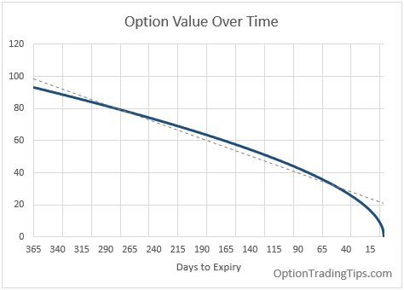
THETA

Slide 72
THETA
Theta is not only affected by time but also volatility.
Options that have higher implied volatilities will also have higher Theta's than their lower volatility counterparts.
The more volatile an underlying instrument, the more chances there are that the stock/future will be trading above/below the strike price of the option by the expiration date.
When the underlying volatility is low, stock price movements are small and create fewer opportunities for profitable movements compared to the strikes.

Slide 73
lowest theta @ ATM
Highest theta @ among more expire

Slide 74
THETA
Theta is always shown as a negative number for both calls and puts when pricing options. That is, it doesn't matter whether you have the option to buy or sell the stock; that option becomes worth less each day that passes.
However, if you were to sell the option your position Theta would then be positive; you would benefit from the passage of time as expiration approaches

Slide 75
Application of Theta (Θ)
The value of option is the combination of time value and stock value. When time passes, the time value of the option decreases.
Thus, the rate of change of the option price with respect to the passage of time, theta, is usually negative.
Because the passage of time on an option is not uncertain, we do not need to make a theta hedge portfolio against the effect of the passage of time.

Slide 76
Application of Theta (Θ)
However, we still regard theta as a useful parameter, because it is a proxy of gamma in the delta neutral portfolio. For the specific detail, we will discuss in the following sections.

Slide 77
Calculate theta
From Black-Scholes model,
S (stock price) = 74.49,
X (strike price)=75,
r (risk free rate) =1.67%,
σ (volatility) =38.4%,
t (time to expire)=15.89% yrs.

Slide 78
THETA
Because N(-d₂)=1-N(d₂), the theta of a put exceeds the theta of the corresponding call by rKe^{-rT}
^{Q= dividend}

Slide 79
THETA
Because N(-d₂)=1-N(d₂), the theta of a put exceeds the theta of the corresponding call by rKe^{-rT}

Slide 80
THETA
Because N(-d₂)=1-N(d₂), the theta of a put exceeds the theta of the corresponding call by rKe^{-rT}

Slide 81
THETA

Slide 82
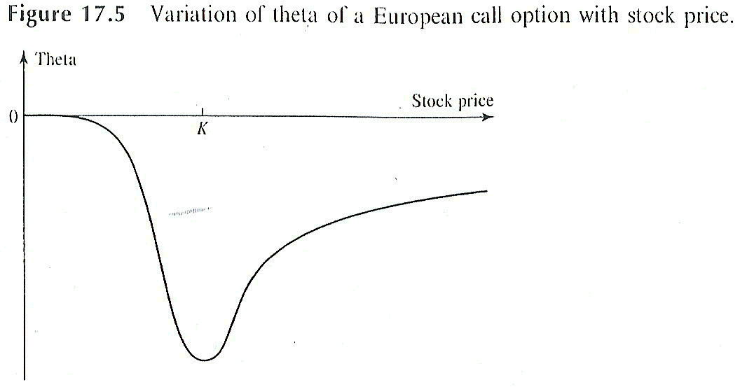
THETA

Slide 83
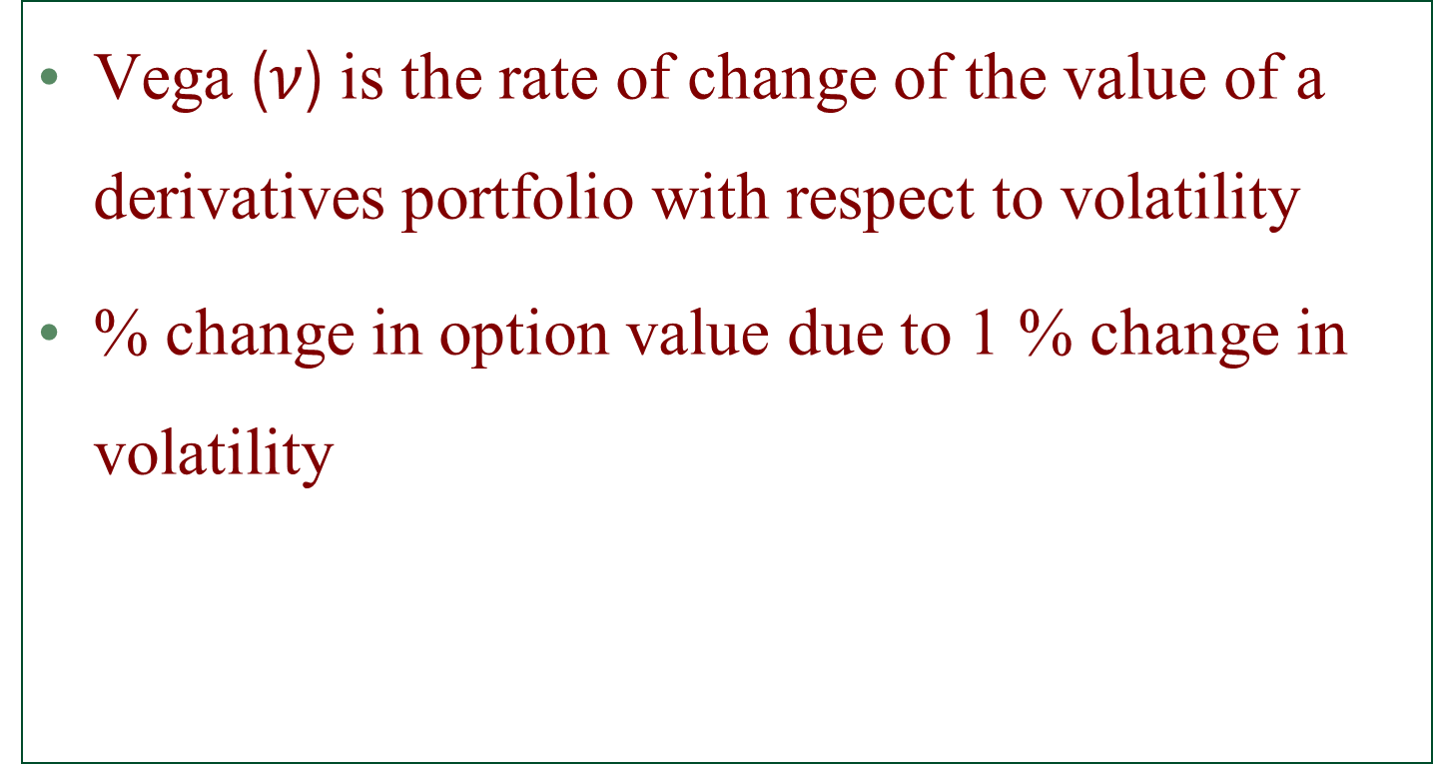
Vega
Vega ($ν$) is the rate of change of the value of a derivatives portfolio with respect to volatility
% change in option value due to 1 % change in volatility

Slide 84
Vega
Vega is quoted to show the theoretical price change for every 1 percentage point change in volatility.
For example, if the theoretical price is 2.5 and the Vega is showing 0.25, then if the volatility moves from 20% to 21% the theoretical price will increase to 2.75.
Vega is most sensitive when the option is at-the-money and tapers off either side as the market trades above/below the strike.

Slide 85
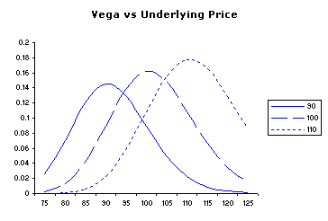
VEGA
The graph plots the option Vega vs Underlying price for 3 different strike prices.
Behavior of an option Vega is similar to Gamma: increasing as the option moves from being in-the-money to at-the-money where it reaches its peak and then decreases as the option moves out-of-the-money.
Note: like the Gamma, Vega is the same value for calls and puts.

Slide 86
Highest vega @ ATM
Highest vega @ among more expire

Slide 87
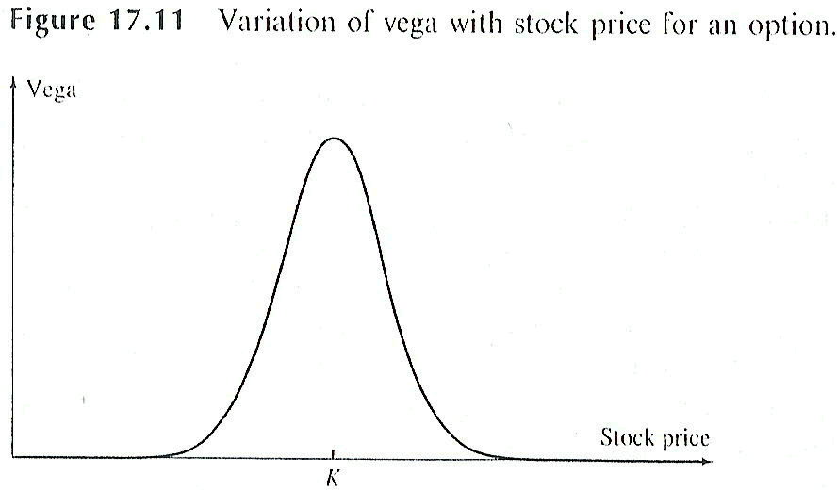
VEGA
For a European call or put option on a non-dividend-paying stock

Slide 88
Calculate VEGA
From Black-Scholes model,
S (stock price) = 74.49,
X (strike price)=75,
r (risk free rate) =1.67%,
σ (volatility) =38.4%,
t (time to expire)=15.89% yrs.

Slide 89
Calculation VEGA
Because N(-d₂)=1-N(d₂), the theta of a put exceeds the theta of the corresponding call by rKe^{-rT}

Slide 90
Calculation VEGA
Because N(-d₂)=1-N(d₂), the theta of a put exceeds the theta of the corresponding call by rKe^{-rT}

Slide 91
Calculation VEGA
.

Slide 92
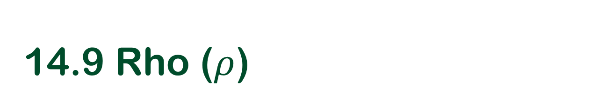
14.9 Rho ($ρ$)
Rho is the rate of change of the value of a derivative with respect to the interest rate
% change in interest rate due to 1% change in interest rate

Slide 93

Rho ($ρ$)
Rho represented as the change in theoretical price of the option for a 1 % point movement in the underlying interest rate.
For example, say you're pricing a call option with a theoretical value of 2.50 that is showing a Rho value of .25. If interest rates increase from 5% to 6%, then the price of the call option, theoretically at least will increase from 2.50 to 2.75.

Slide 94
Calculate Rho
Call Rho = T * K * e^{-T*r} * N(D₂)
Call Rho = 0.1589 * 75 * e^{-0.1589*0.0167} * N(-0.10378)
Call Rho = 0.1589 * 75 * e^{-0.1589*0.0167} * N(-0.10378)
Call Rho = 11.9175 * e^{-0.1589*0.0167} * 0.458672
Call Rho = 11.9175 * 0.99735 * 0.458672
5.451737

Slide 95
Calculate Rho
Put Rho = -T * K * e^{-T*r} * N(-D₂)
Call Rho = -0.1589 * 75 * e^{-0.1589*0.0167} * N(0.10378)
Call Rho = -0.1589 * 75 * e^{-0.1589*0.0167} * N(0.10378)
Call Rho = -11.9175 * e^{-0.1589*0.0167} * 0.541328031
Call Rho = -11.9175 * 0.99735 * 0.541328031
-6.43418

Slide 96
Relationship Between Δ, Θ, and Γ
Delta (D) is the rate of change of the option price with respect to the underlying security
Gamma (G) is the rate of change of delta (D) with respect to the price of the underlying asset
Theta (Q) of a derivative (or portfolio of derivatives) is the rate of change of the value with respect to the passage of time.

Slide 97
14.7 Relationship Between Δ, Θ, and Γ
The price of a single derivative dependent on a non-dividend paying stock must satisfy the Black-Scholes-Merton differential equation:

Slide 98
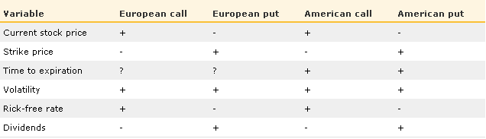
Factors that influence put and call prices

Slide 100


That’s all for the DAY!!!

